Slide 1
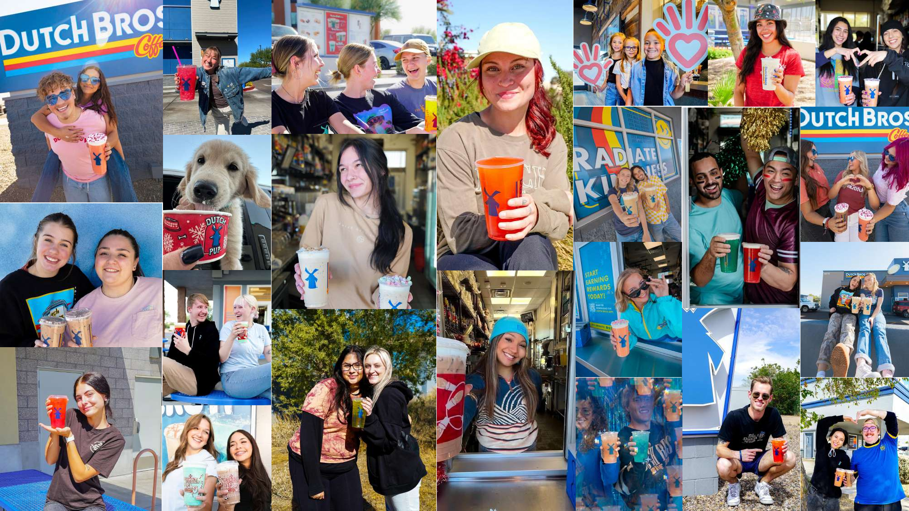
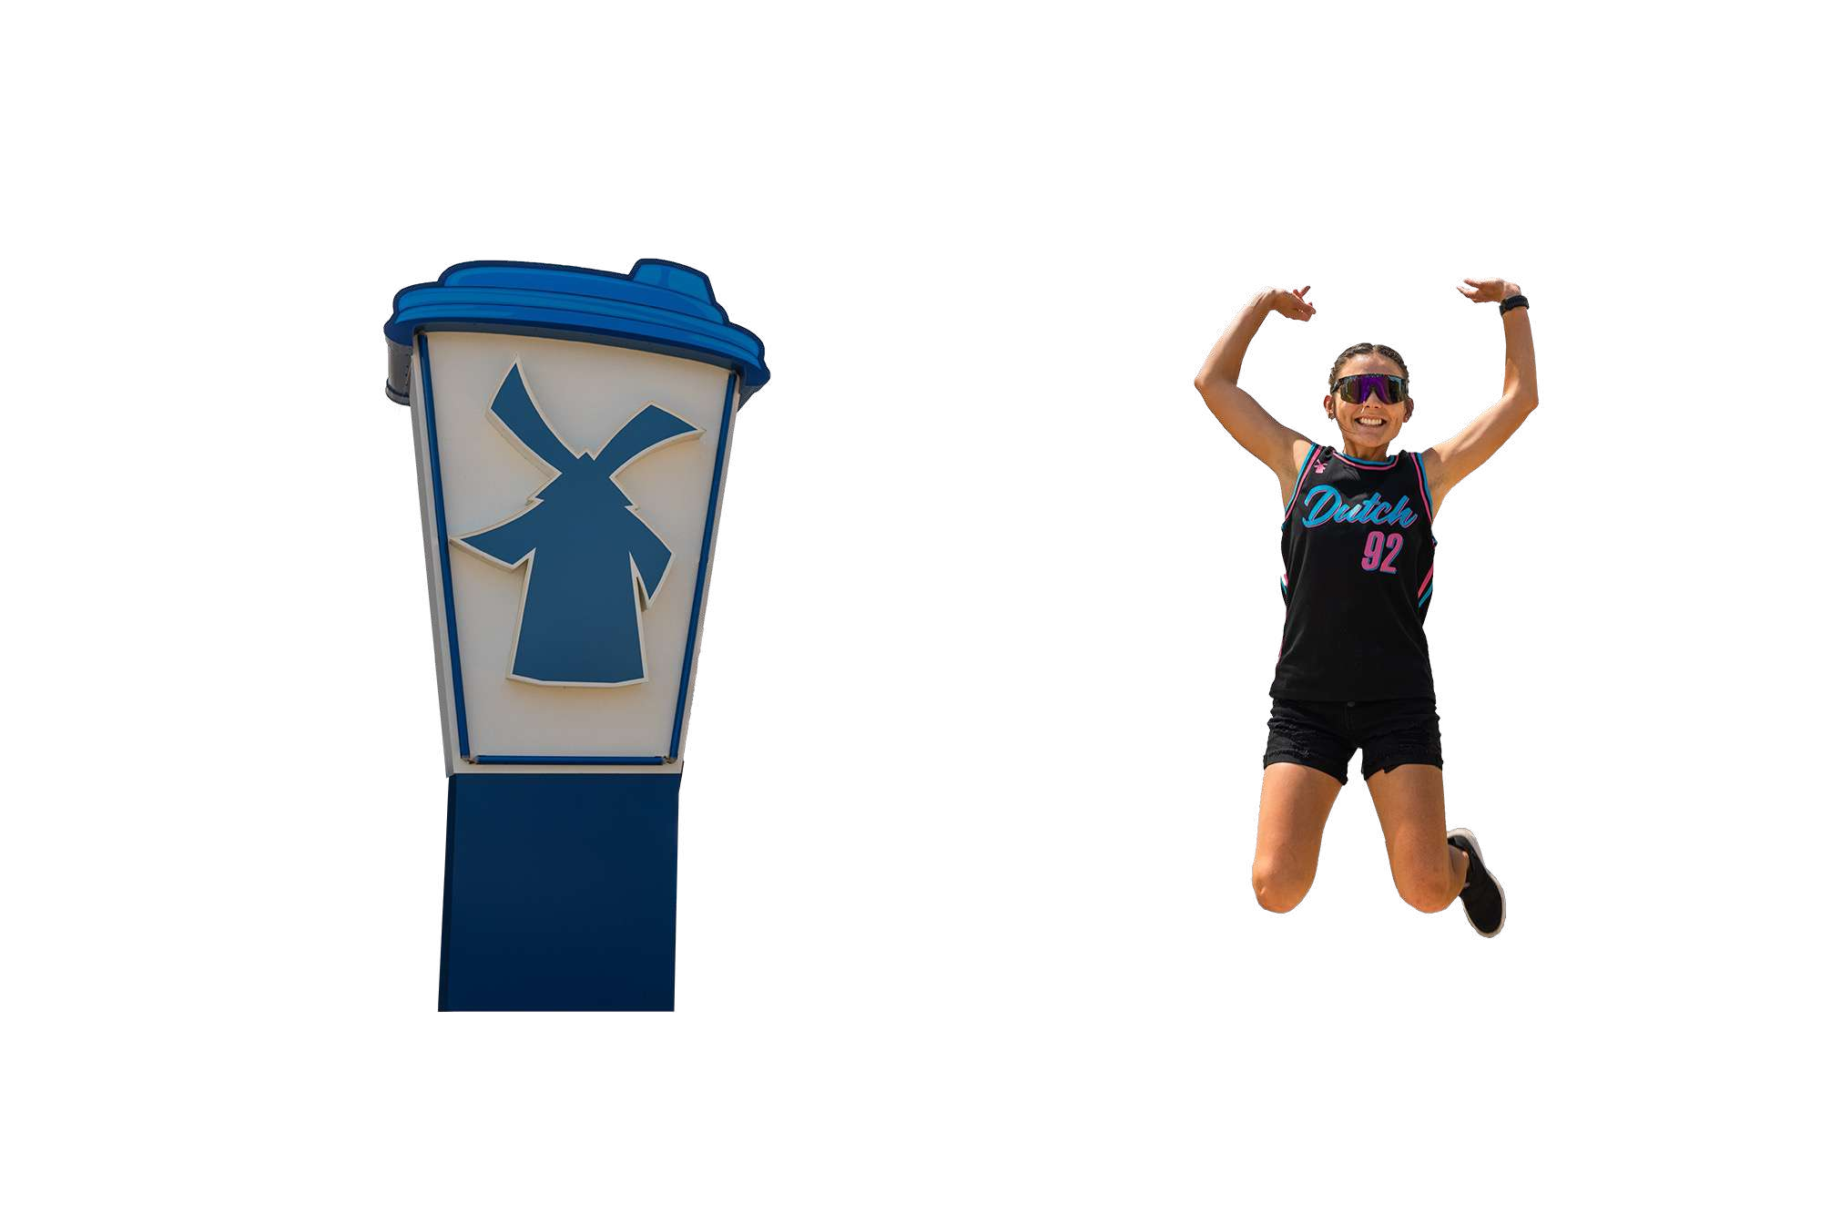



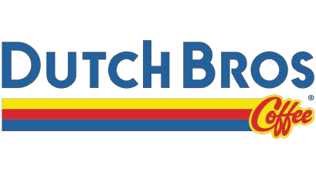

Millie
A Dutch Bros Co-Pilot
Automation does the typing; broistas keep the magic.
Voice-to-Order • DutchPass QR Analytics • KDS Automation • Predictive Ops

Slide 2

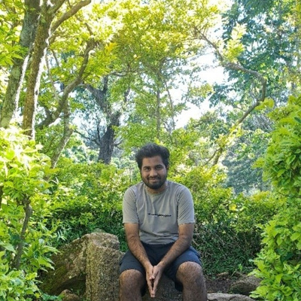





Team 2169
Lekshman Babu
MS Data Science
Ira.A.Fulton School of Engineering
Ben Stewart
MS Computer science
Ira.A.Fulton School of Engineering
Maanesh Mohanraj
MS Data Science
Ira.A.Fulton School of Engineering
Jeffrey John Kennedy
MS Business Analytics
W.P.Carey School of Business
Vijai Kumar
MS Data Science
Ira.A.Fulton School of Engineering

Slide 3


Problem Statement
Typing steals time: complex drink + modifiers = slow, error-prone
Customer context is late: DutchPass scanned at the end, not the start
No “usual” prompt: personalization is manual during a rush
KDS isn’t proactive: no rush alerts; no shared ETAs across items
Training burden: new broistas struggle with manual system

Slide 4
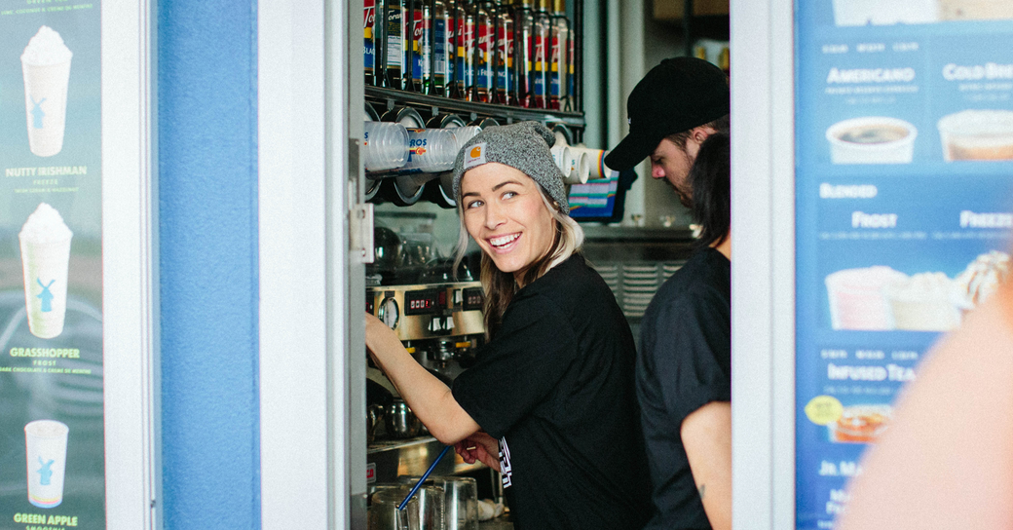
Solution
QR Code
Customer Analytics
Live Transcription
Peak hour Notifications
Smart Recommendation Engine

Slide 5
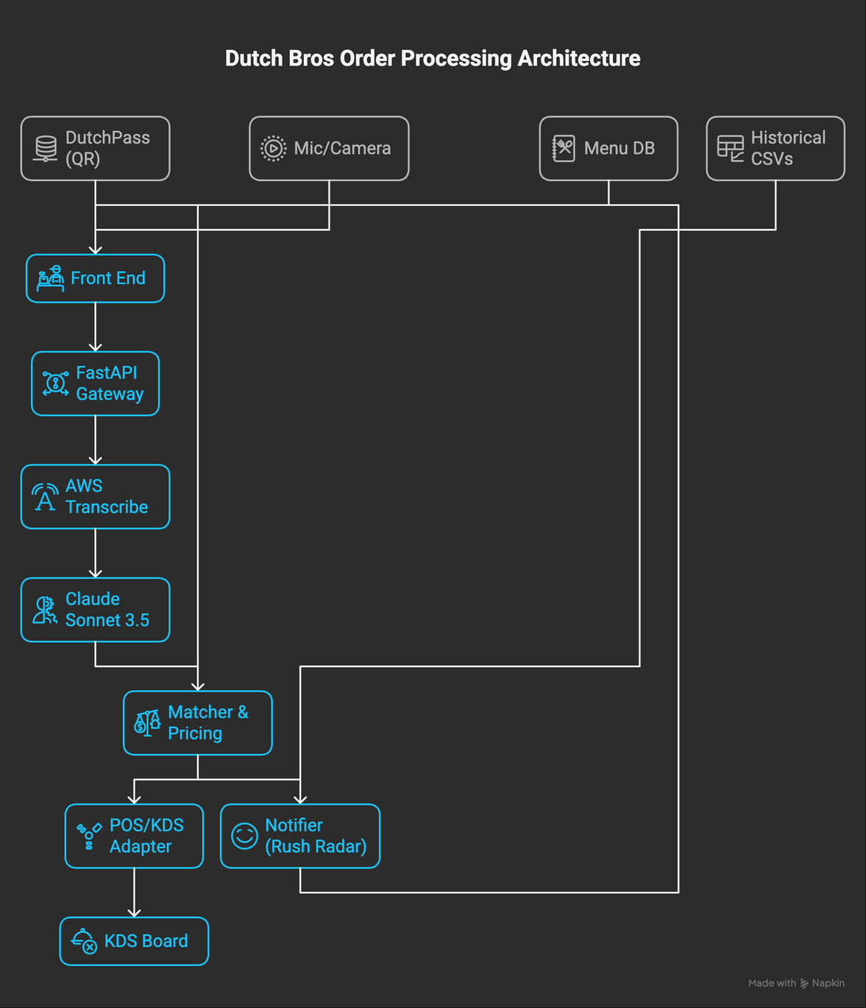
Workflow

Slide 6

PRODUCT DEMO

Slide 7
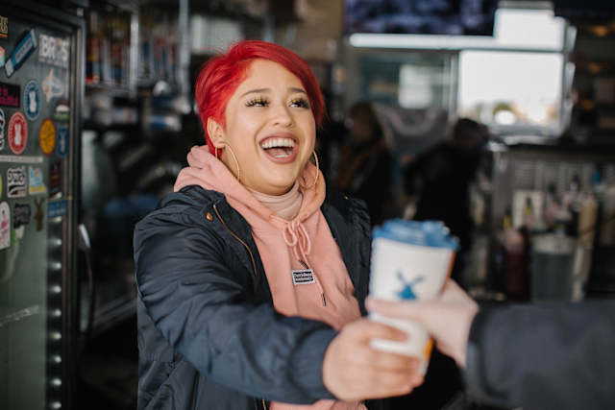
Business Impact
Speed: remove typing; line time drops (esp. peaks 7–10a, 11–2, 7–10p)
Accuracy: modifiers captured; remakes reduced
Connection: broista eyes-up; “The Usual” is one-tap authentic
Operational calm: Rush Radar + ETAs = fewer fire-drills
Security: mTLS to gateway; server-side SigV4; no AWS keys in browser.
Millie 2.0
Loyalty API + personalized offers
Better noise handling
Kiosk & mobile voice; A/B testing
Inventory forecasting from demand signals

Slide 8
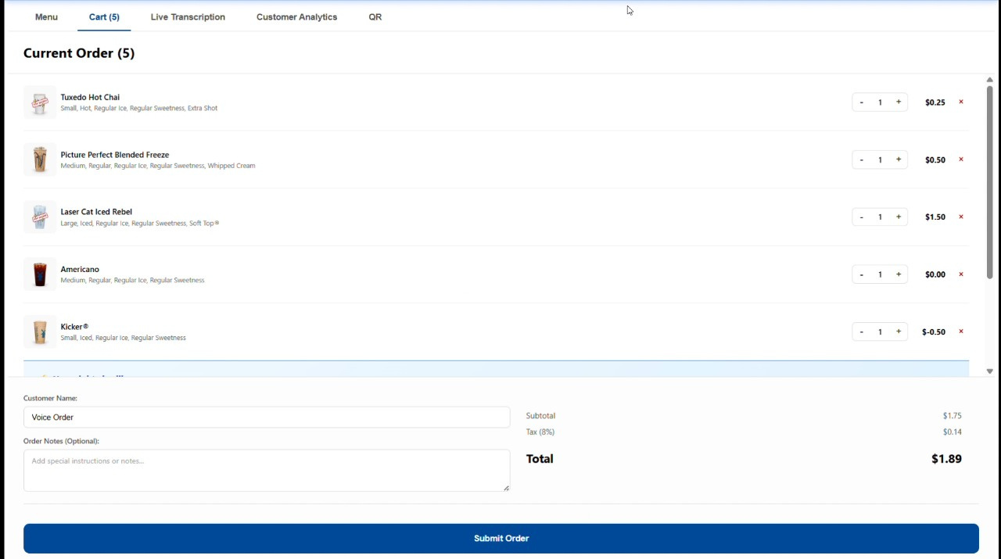
Appendix
Final output screenshot from Millie

Slide 9
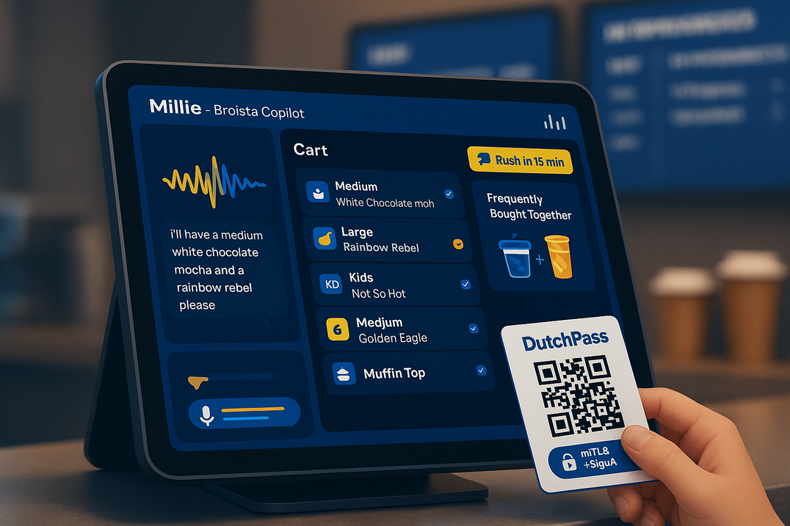
End of Presentation and Ready for Q&A

